Slide 1

How Do NBA Teams Plan
All-Star Players' Salaries?
GROUP 13
CHENYU WANG
GEUNJU PARK
PANAGIOTIS GEORGIADIS
SHANSHAN TAN
XIAOXUE JI
Notes:
Let me know the student number!
Hello everyone, we’re Group 13, and today we’ll be presenting on ’How Do NBA Teams Plan All-Star Players' Salaries’. Starting with introducing the business problem, we’ll walk you through three models we used and share the insights and recommendations we gained from this project.

Slide 2

Business Problem
Issue
> Financial strain due to high salary for low-performing players
Strategy
> Identify underperforming players with high salaries using past performance data
Business Goal
> Predict fair salaries to avoid overpayment
Stakeholder
Athletes
Owner
Opportunity
Humanity
Considerations
Balancing Historical Contributions with Salary Decisions
Potential Bias from Relying on Data Models
Achieve Financial Stability
Increase Club Revenue
Notes:
The NBA market is massive, and All-Star players are a big deal since being an All-Star can really impact a player's salary. But, not every salary out there matches the player's actual performance. When that happens, it can put financial strain on teams, and in the long run, it might even hurt their competitiveness.
That’s why we wanted to dig into this and see if we could predict who might become an All-Star and estimate the right salary for them. If teams can get this balance right, they could secure a more stable financial future, which would boost their profitability, too.
Of course, it’s important to remember that salary isn’t just about stats. There are human factors, personal situations, and other influences beyond just game performance. I’ll touch more on those considerations later on. Stakeholders and opportunity can be found on the right side.

Slide 3
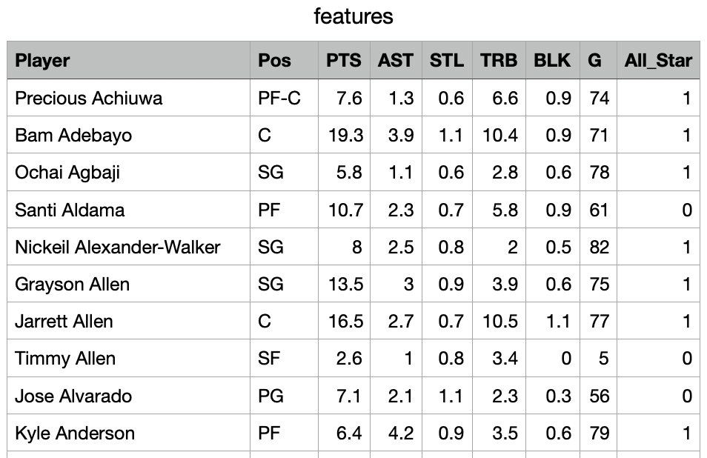
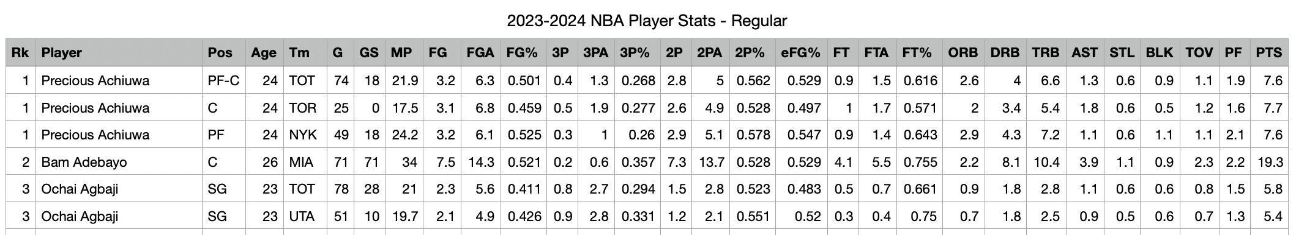
Data Mining Problem
Model 1 : All-Star Prediction Model
Data : 2023-2024 Performance
Supervised Machine Learning Method : Random Forest with 50,000 trees
Relevant Performance Measures : Accuracy, AUC-ROC, Confusion Matrix
Partitioning : Training(60%), Validation(40%)
Variables
Output : 1: All-Star Player / 0 : not All-Star Player
Input : POS, PTS, AST, STL, BLK, TRB, G
Notes:
So our first model aims to predict the All-Star potential of NBA players based on performance stats. To build this model, we used a dataset of NBA players and applied a random forest algorithm, which is ideal for classification tasks like this due to its ability to handle both numeric and categorical data. From this model, we would like to know if a player is All-Star player or not. On the right side, you can see the cleaned data that we used for random forest modelling.

Slide 4
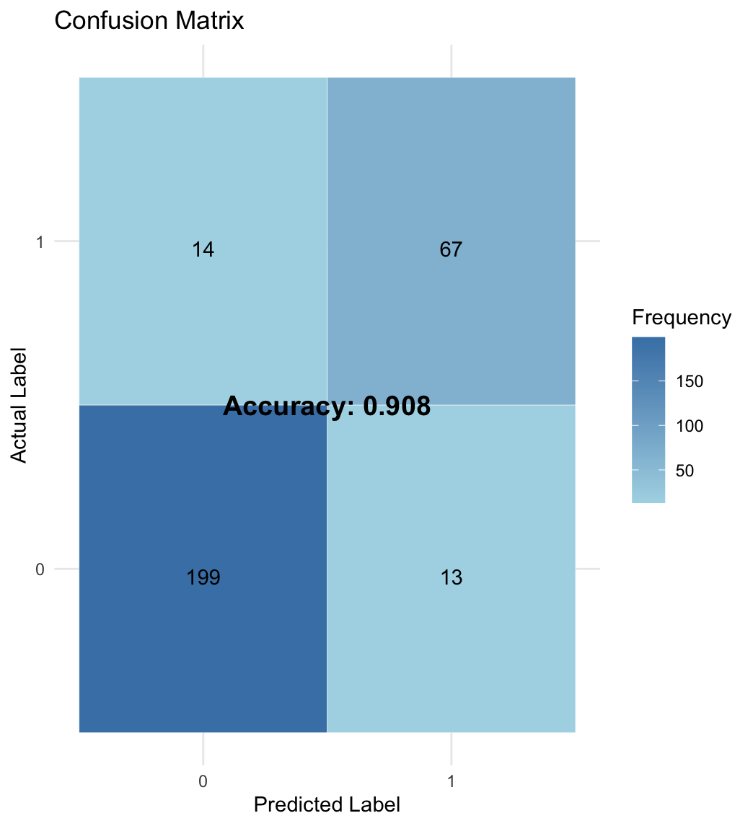
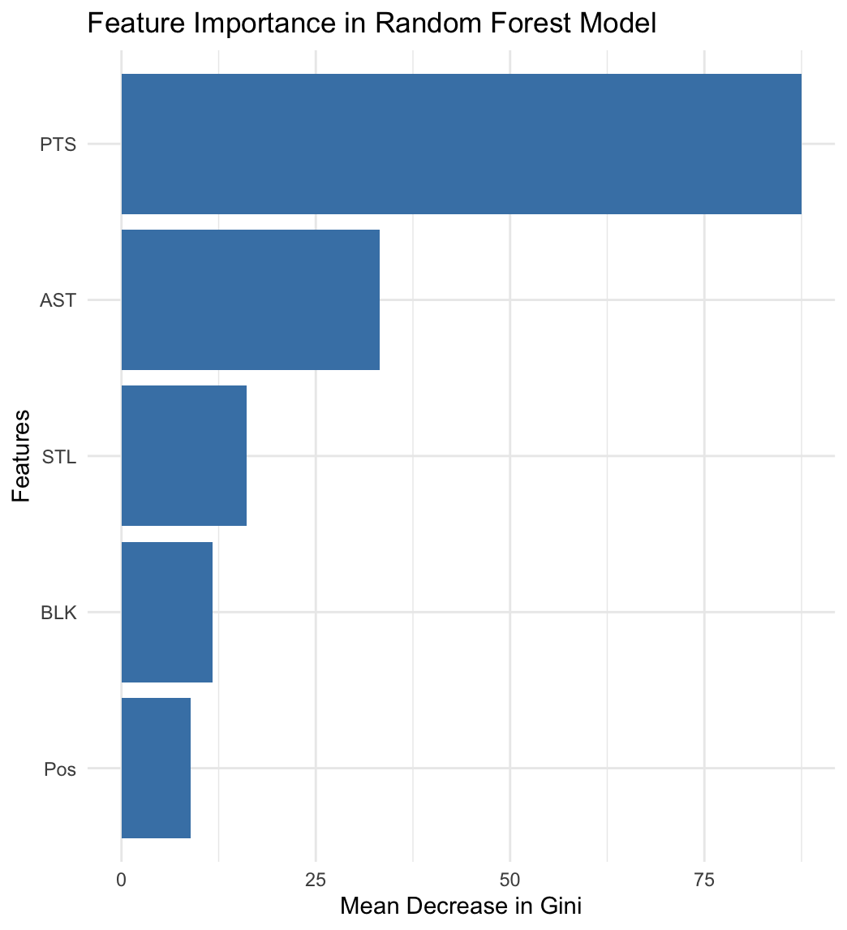
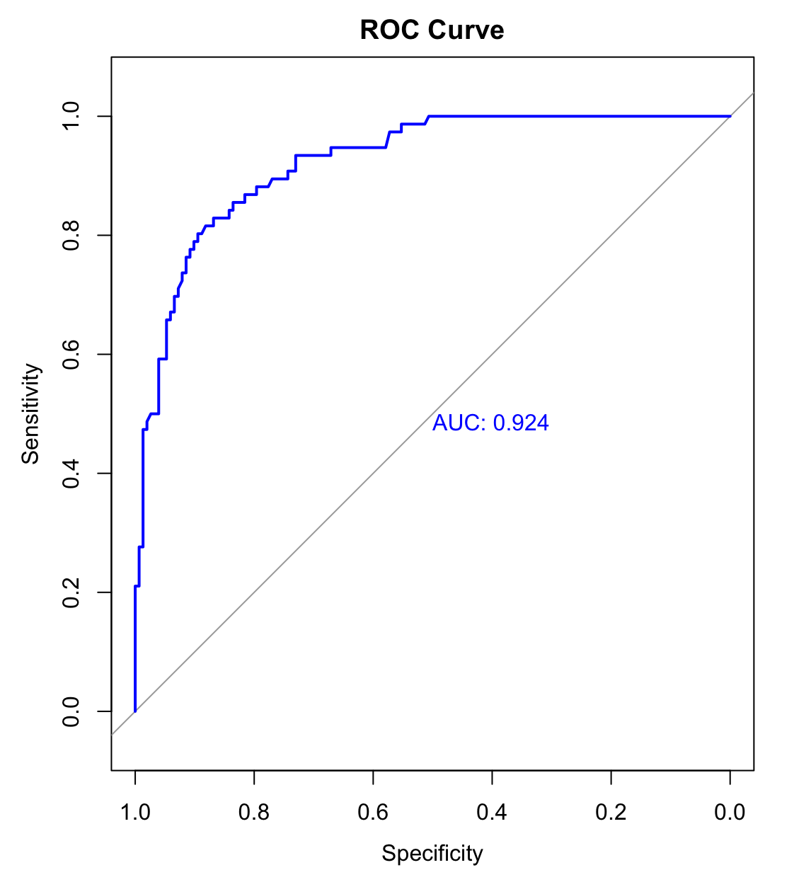
Model 1 : All-Star Player Prediction Model
Model Accuracy Evaluation
Model Accuracy
Notes:
Starting with Model Accuracy Evaluation, we have the confusion matrix on the left. Our model achieved an accuracy of 90.8%, which shows a solid predictive capability. This matrix provided a clear picture of how well the model predicted All-Star potential and helped us make adjustments where necessary.
Next, in the Feature Importance chart, you can see which factors most influence All-Star predictions. Points (PTS) is the most impactful feature, followed by assists (AST) and steals (STL). This means players who score high points and assists are more likely to be classified as All-Stars.
After data cleaning, we used PCA on key variables to calculate the variance explained by each principal component. We then weighted these components to create a composite score, identifying the top 75% as All-Star players. Finally, we split the data into training (60%) and validation (40%) sets, trained a random forest model, and evaluated its performance using a confusion matrix and ROC curve. About ROC curve, the model achieved an impressive AUC score of 0.965. This high score means the model can effectively distinguish between players with high and low All-Star potential.

Slide 5
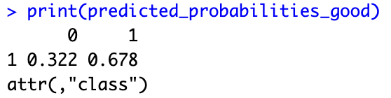
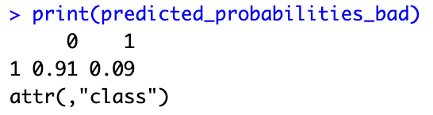
Model 1 : All-Star Player Prediction Model
Return list
Predict the All-Star status
for the new player
How much overlap between the predicted All-Star players and the actual All-Star players
Good player "PG", PTS = 20, AST = 10, STL = 10, BLK = 10
Player | Match
LeBron James | 1
Kevin Durant | 1
Nikola Jokic | 1
Anthony Davis | 1
Kawhi Leonard | 1
Paul George | 1
Alperen Sengun | 1
Victor Wembanyama | 1
Chet Holmgren | 0
Karl-Anthony Towns | 0
Luka Doncic | 1
Stephen Curry | 1
Shai Gilgeous-Alexander | 1
James Harden | 0
Bad player "PG", PTS = 5, AST = 2, STL = 2, BLK = 1
Good players
have higher potential to become All-Star Player
75% match
Notes:
Through this model, we wanted to see how well the predicted All-Star players match the actual All-Star players. To do this, we generated a list that shows the match results, and we found that 75% of the players matched. The chart on the left shows a portion of our match list, where players marked with a "1" are those who successfully matched.
To test this further, we created hypothetical cases for new players. We assigned different weights based on whether a player is considered "good" or "bad." We put different weights for each features depending on the category of players. As a result, a good player showed a 67.8% chance of being an All-Star, while a bad player had only an 9% chance. These probabilities offer actionable insights, helping teams identify and focus on high-potential players in real-time decision-making.

Slide 6
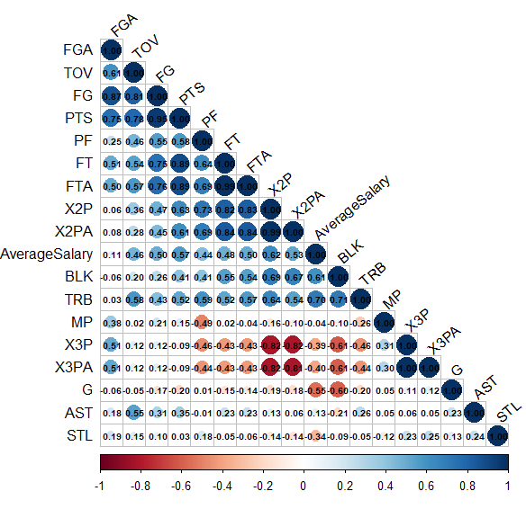

Data Mining Problem
Model 2 : Performance - Salary Prediction Model
Data : 2021-2024 Performance, 15 All-Star Players Salary
Supervised Machine learning method : Random Forest with 50,000 trees
Relevant Performance Measures : R², Confusion Matrix
Partitioning : Training (100%)
Variables
Output : prediction result
Input : All of numeric variables
Notes:
Based on the insights from our first model, we wanted to try predicting players' salaries ourselves. The data we used here is similar to the previous data, but we included a longer time span.
Before we start to analyze salary, we merged and cleaned the data. After that, we analyzed the relationships between various features in the dataset, focusing on how they correlate with each other. You can see that we found a correlation between average salary and PTS, and FTA on this chart.
(new confusion matrix)
So, based on this, we built a Random Forest model to predict the players' salaries, and we evaluated the model by comparing the predicted salaries with the actual ones. This comparison helps us assess the accuracy of the model. In the process, we looked at the feature importance, and it turned out that metrics like Total Rebounds and Blocks per Game had a significant impact on the predictions. This means that players' performance in these areas was a key factor in determining their predicted salary.

Slide 7
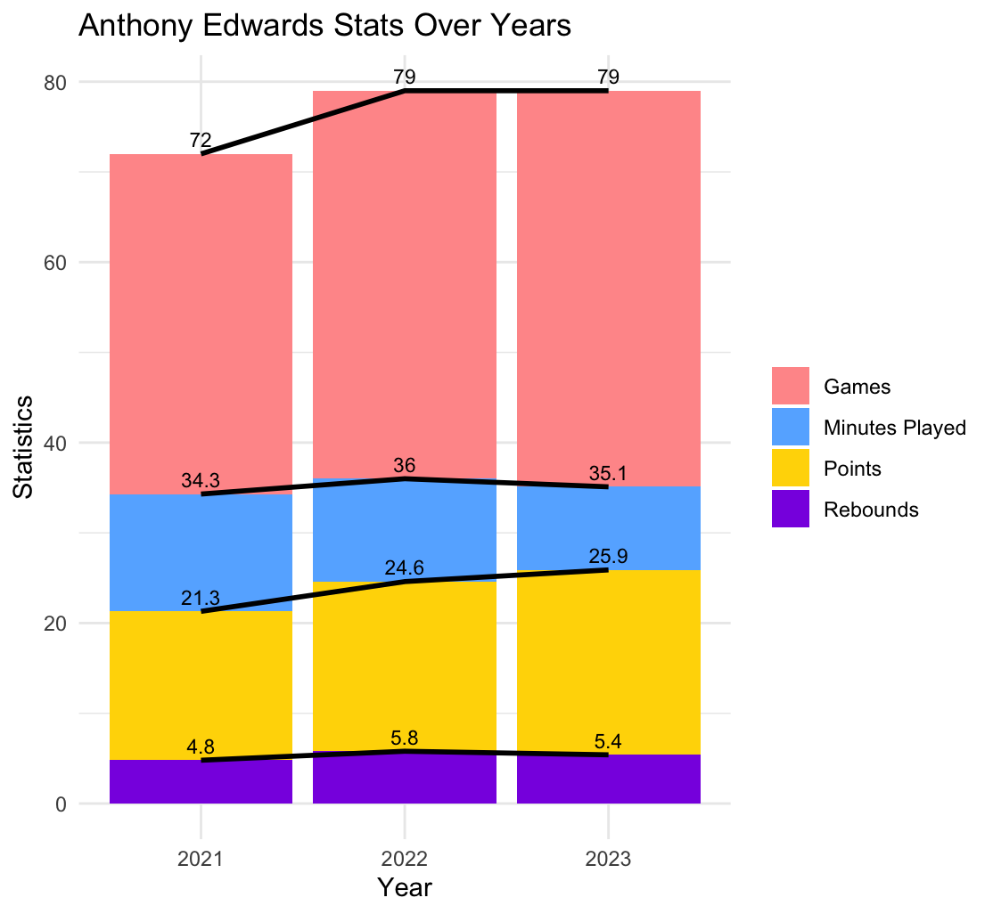
Model 2 : Salary Prediction Model
Anthony Edwards
Increased
: because of performance and potential
James Harden
Decreased
: because of his performance
Well played, should increase salary
Notes:
Next, we took a closer look at the actual salaries versus the predicted ones. For instance, we found that Anthony Edwards had a predicted salary about 1.64 times lower than his actual salary. If you look at the graph on the left, you'll notice that his playing time (in blue) increased, which made us expect his salary to rise. And sure enough, when we compared the predicted salary to the actual one, we saw a corresponding increase, as shown in the table on the right.
To evaluate how well the model was performing, we checked the R-squared value, which came out to be 0.89. This is very close to 1, which indicates that the model is doing a great job of explaining the variation in the salaries.
However, we also saw a discrepancy with James Harden. His predicted salary was lower than his actual salary. This was because, based on his performance stats, the model predicted a lower salary. I'll discuss this limitation a bit more later in the presentation.

Slide 8
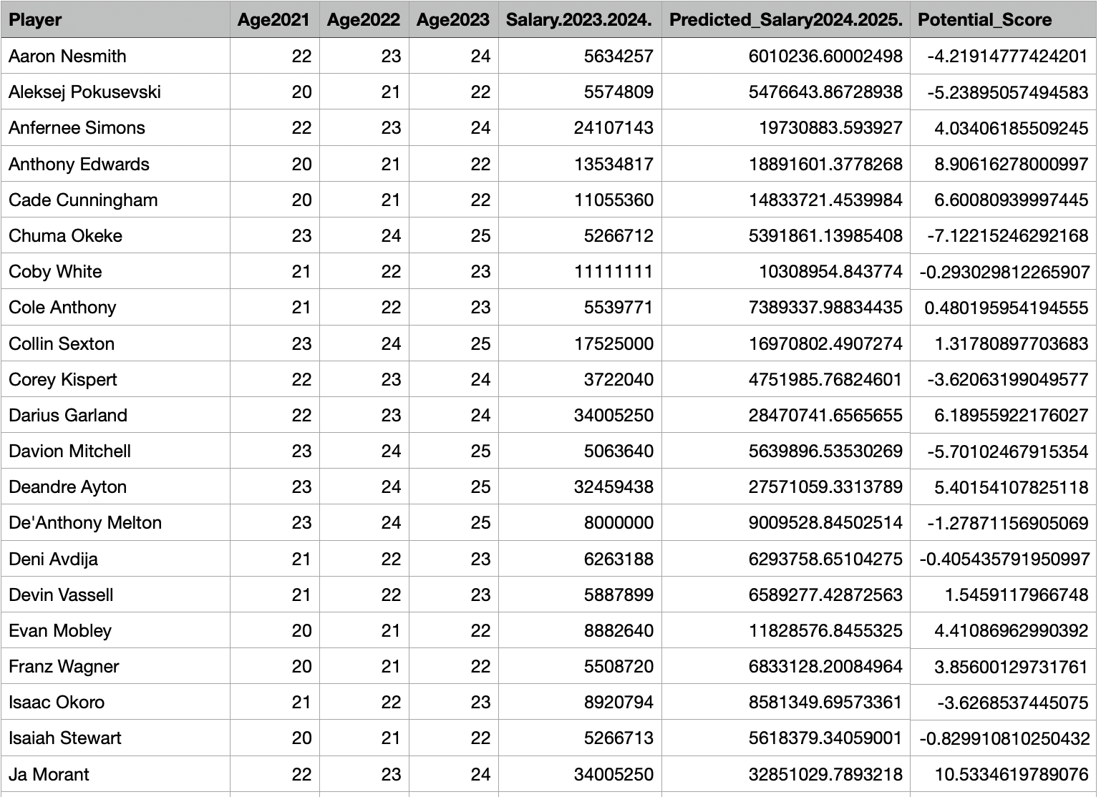
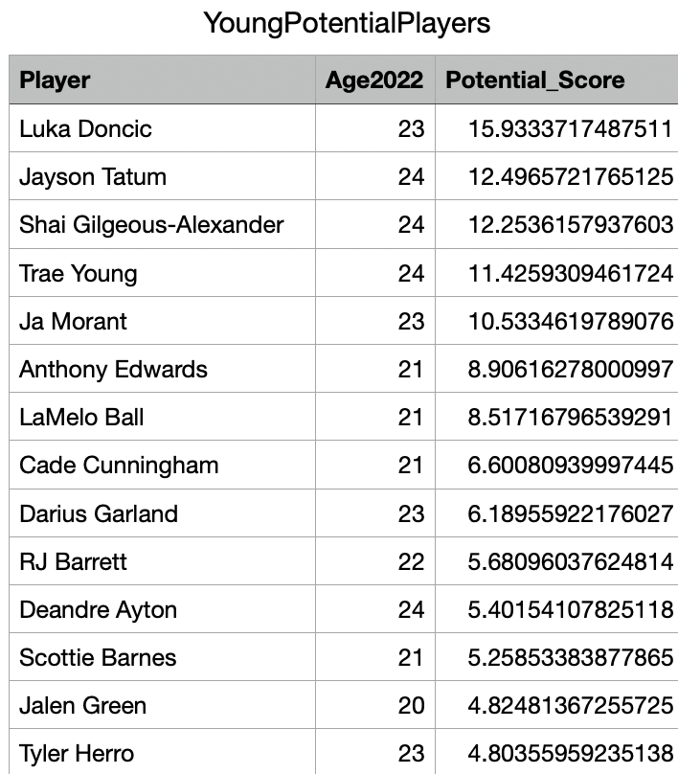
Data Mining Problem
Young potential players’ salary prediction
through Random Forest
Model 3 : Potential Player’s Salary Model
Data : 2021-2024 NBA Player Stats, Code_2_15AllStarPlayersSalaries
Supervised Machine learning method : Random Forest with 50,000 trees
Relevant Performance Measures : R², Clustering
Partitioning : Training (100%)
Variables
Output : Player salary and statistics data for multiple seasons, along with selected columns and filters.
Input : A dataset of young players with their potential scores, predicted salaries, K-means cluster labels, and a final filtered dataset showing undervalued players.
Notes:
After reviewing the second model, it’s clear that the market would likely want to bring in players with higher potential. So, in the third model, I decided to assess the potential of young players and predict their salaries using their year-by-year stats and salary data. First, I selected players under 25 and, based on Principal Component Analysis (PCA), I calculated a potential score to identify the young potential players. You can see this in the chart on the right.
Next, I used a Random Forest model to predict the players' salaries for the 2024-2025 season. The model was trained using various salary data from previous seasons. By integrating the predicted salaries into the original dataset, we can forecast how much players will earn in the next season.

Slide 9
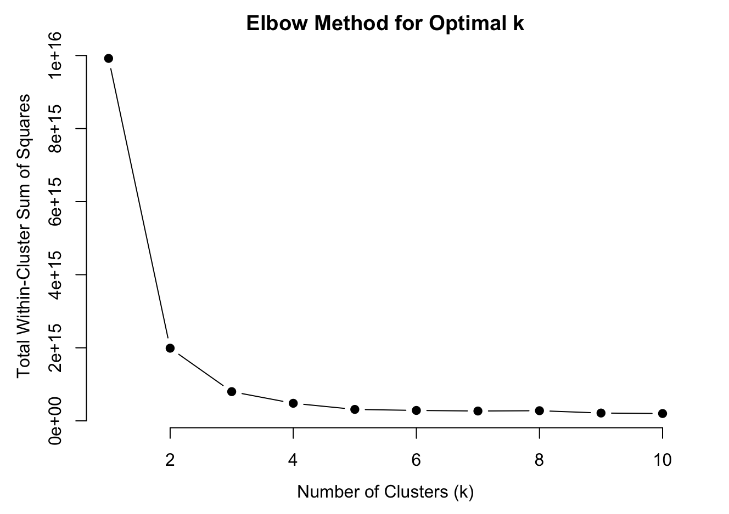
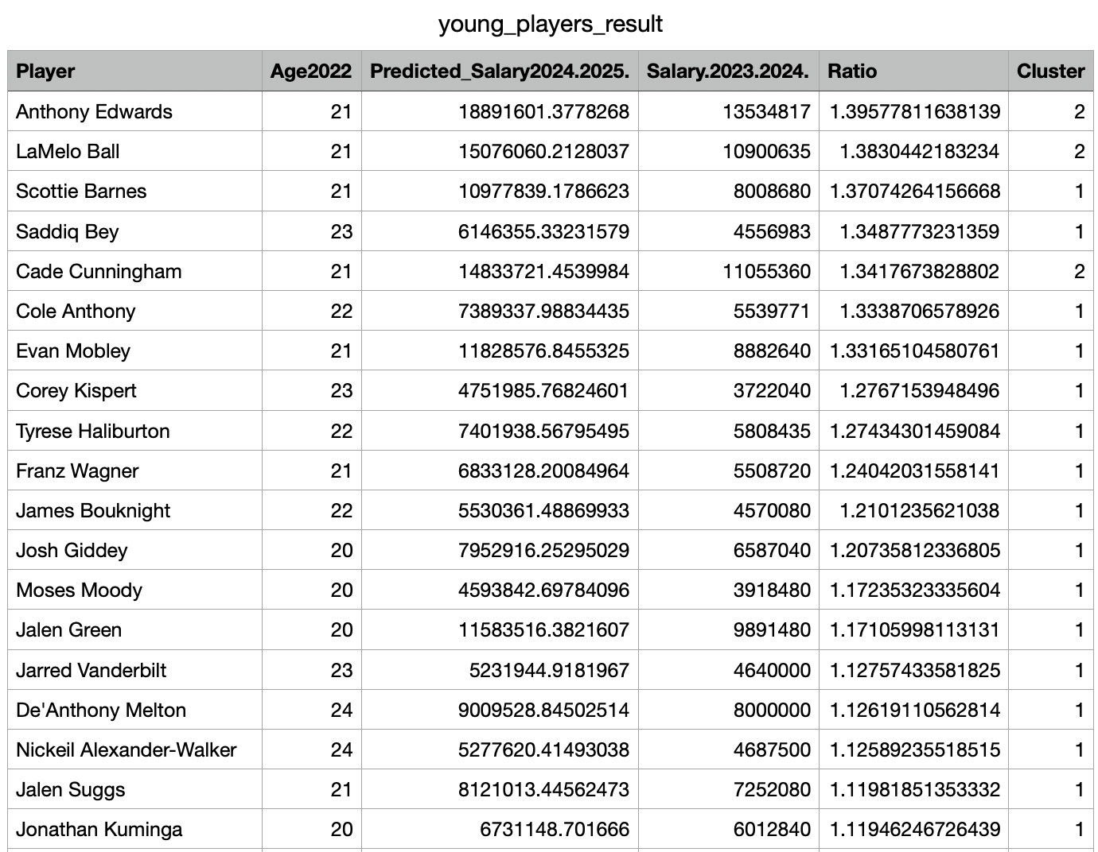
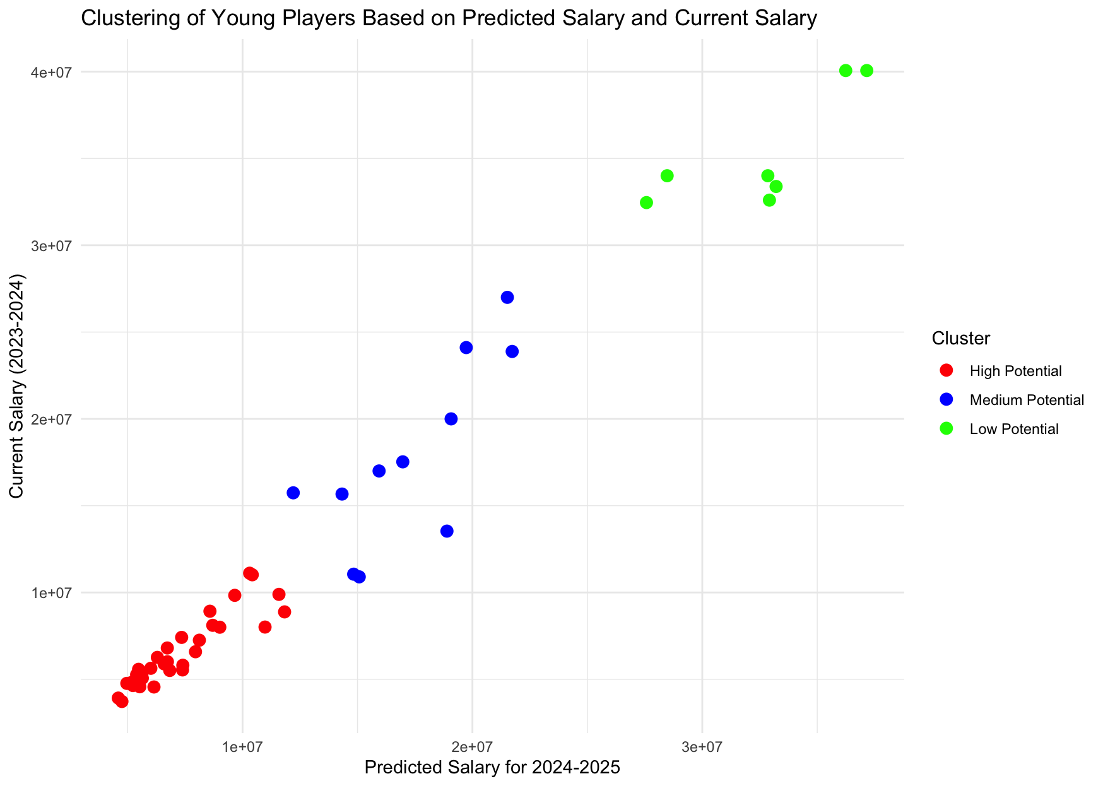
Model 3 : Potential Player’s Salary Model
Clustering Result
K-means
Notes:
To classify the players into high, medium, and low potential groups, we applied the elbow method to determine the optimal number of clusters. Based on the graph, we chose k=3 clusters. Using K-means clustering, we assigned players to one of these three categories: High Potential, Medium Potential, or Low Potential. You can see the clusters and how they relate to the players' predicted and current salaries in the chart on the right.
This model helps assess the players’ potential more accurately and predicts their future salaries. It provides a strategic tool for teams to identify players who are most likely to succeed in the future, ultimately helping them make informed decisions when acquiring new talent.

Slide 10
Recommendations
Key Insights
Recommendation
Model
Accuracy
Mitigating Financial Risks
Enhancing Competitiveness
1. Integrated
Decision-Making
2. Dynamic Adjustments
Challenges in Predicting
Player Value
Notes:
With this model, we can accurately predict player performance and salary, leading to smarter salary strategies. It reduces financial risk by preventing overpayment, which eases long-term financial pressures. Ultimately, an optimized salary structure keeps high-potential players on board while allowing flexibility for future seasons.
However, like I mentioned during the second model, predicting player value isn't always straightforward. Like Jamse Harden, it was more about honoring his legacy than his performance stats. This example really shows how our model falls short when it comes to handling the emotional and ethical sides of these decisions.
To wrap up, here are a couple of recommendations. First, while the model provides valuable insights into player potential and salary predictions, it’s important to supplement these results with feedback from management and coaches. Their knowledge of a player’s character and fit within the team can provide crucial context that the model might miss.
Second, to ensure the model remains accurate and relevant, it should be regularly updated with the latest player statistics and market trends. This ensures that salary predictions stay aligned with any changes in player performance or shifts in the overall market.
This concludes the presentation. Thank you for your attention.

